Slide 1
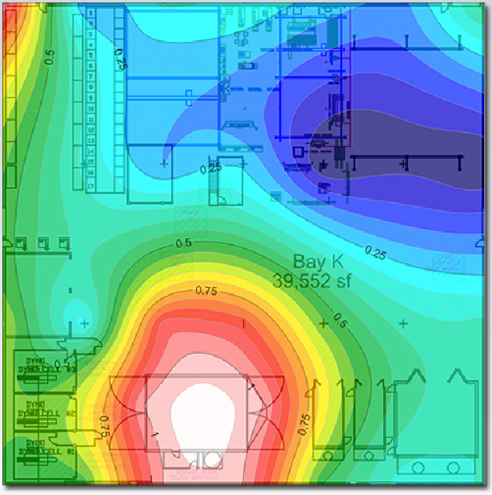
HexChecks™ Dust Migration Mapping™
Technical Summary
Chromium dust is 8x more likely to cause cancer than asbestos. Hazardous dusts containing chromium and cadmium, and other toxins are generated during common industrial processes, including media blasting, grinding, sanding, and welding, and migrates far from the source. Swipe sampling and other conventional dust migration measurement methods are frustratingly unreliable and unhelpful for dust exposure mitigation.
HexChecks Dust Migration Mapping™ technology makes migration measurement reliable and meaningful. The result is rapid visualization of migration pathways, stress-free management-of-change, and simple spot check monitoring for long-term maintenance. Dust Migration Mapping can satisfy OSHA requirements for remedial action following a citation and can proactively protect Voluntary Protection Program status.
Operational Capabilities
HexChecks Dust Migration Mapping™ is an engineering service that measures, analyzes, and characterizes respirable hazardous dust and aerosol movement within closed environments.
Dust Migration Mapping™ can:
Characterize dust and aerosol migration patterns for hazardous materials, such as:
Chromium
Cadmium
Beryllium
Lead
Volatile Organic Compounds (VOCs)
Detect dust migration pathways
Identify unknown hazardous generators
Provide empirical data for management-of-change evaluation
Provide long-term process control
Help establish regulated area boundaries
Satisfy OSHA requirements for remedial action following a citation.
Protect VPP status
This dust migration map shows the extent of a known primary dust source (lower center) and identified an unknown secondary source in a welding cell (upper left).
Government and NDIB Applications
Supplement or replace existing monitoring programs using
ASTM D6966 (General Metals)
ASTM E1728 (Lead)
ASTM D6480 (Asbestos)
NIOSH 7702 (Lead)
Industrial and Sustainment Applications:
Media blasting
Sanding, grinding, abrading
Welding
Painting
Plating and stripping
Nanotech and Biotech Applications:
Nanoparticle and composites fabrication
Clean rooms
Fume hoods
Healthcare facilities
Building renovation
Mining and underground excavation

