Slide 1
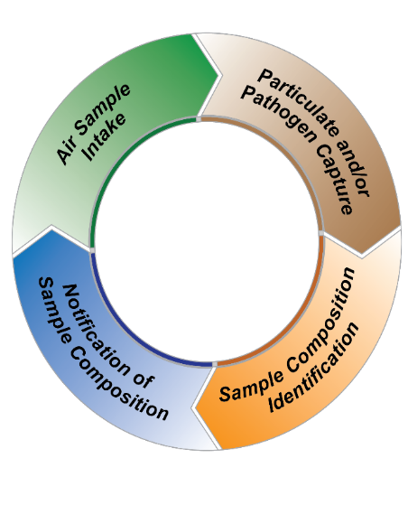
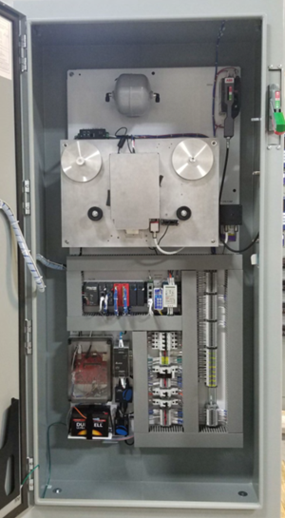
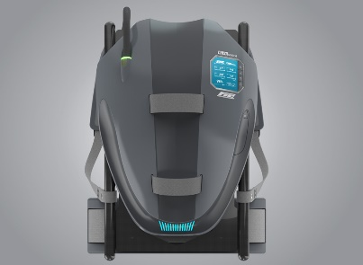
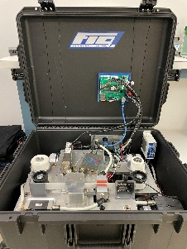
HexChecks Continuous Hazardous Environment Monitor (CHEM™)
Summary
HexChecks CHEM™ monitors air quality by sampling the environment, capturing particulate, and determining both elemental composition and concentration in 5-10 minutes. The CHEM™ sensor will serve the need of the Department of Defense as an operator process safety tool. Future capabilities involve rapid airborne pathogen identification to revolutionize environment monitoring efforts for public and occupational safety, U.S. warfighter safety, and first responder diagnostics.
Advantage: Deploy in a variety of environments due to versatile and advanced analysis methods
1
2
Advantage: Maintain loaded filter samples for later analysis
Process
Steps
Advantage: Minimize lab labor hours and equipment
4
Advantage: Analyze composition in 5-10 minutes vs lab response of 72 hours
3
Formats, Features, and Applications
Mounted CHEM System | Portable CHEM System | Wearable CHEM System
Outlet powered for 24/7 operation
Chemical/manufacturing plant air quality monitor
Closed-loop ventilation monitor
Urban environment monitor for public safety
Outlet or battery powered
Site-visit evaluation
First responder
Warfighter airborne hazard identification
Battery powered
Process environment monitor for operator safety
First responder/Warfighter airborne hazard identification
Potential Customers
Defense and Aerospace
Maintenance, Repair and Overhaul (MRO) facilities
Combat vehicle and portable warfighter systems
BioWatch Program, Department of Homeland Security
State and local first responders
Industrial manufacturing and fabrication plants
EPA for Superfund remediation efforts
Mineral and raw material processing plants
Third party occupational safety audit companies

